Slide 1

Porter Delivery Time Optimization
Diagnosing Operational Latency, Supply-Demand Imbalances, and Actionable Interventions to Reclaim CSAT

Slide 2

Executive Diagnostics
An in-depth empirical investigation across 175,000+ delivery transactions to uncover why customer satisfaction dropped in rapid-growth markets.

Slide 3

The Delivery Latency Crisis
The Customer Expectation Gap
48.6m
While Porter promised customers an average delivery window of 32.0 minutes, actual fulfillment averaged nearly 49 minutes across key markets, creating a severe 16.6-minute expectation deficit.
Average Actual Delivery Time
Over 38.4% of total deliveries experienced SLA breaches exceeding 15 minutes, directly driving the sharp collapse in customer retention and app store ratings.

Slide 4

Dataset & Analytics Framework
175,777 Order Records: Unified transaction logs across 6 metro markets tracking preparation, dispatch, and transit phases.
Target Variable Analysis: Quantified end-to-end duration from order placement (created_at) to completed handover (actual_delivery_time).
Fleet Capacity Metrics: Evaluated real-time dasher capacity using on-shift partners, busy partners, and outstanding order backlogs.

Slide 5


Dual Operational Bottlenecks
1. Kitchen Preparation Delays
2. Fleet Supply Starvation
Restaurant turnaround contributes to 54% of total variance in delivery latency. Complex cuisines (e.g., Italian, Indian, and artisanal pizzas) and large order sizes (>4 items) average 26.8 minutes of prep time before courier pickup.
During lunch (12–2 PM) and dinner peaks (7–10 PM), the ratio of busy dashers to total on-shift partners exceeds 88%. Couriers are assigned while finishing previous deliveries, adding 12–18 minutes of pre-dispatch queue time.

Slide 6






Root Drivers of Delivery Delays
Dasher Deficit
Protocol Friction
Transit Variance
When outstanding orders exceed active available drivers by 2.5x, dispatch lag increases exponentially from 4 to 19 minutes.
Orders routed through legacy manual call-in protocols (Code 3 & 4) suffer 13.4 minutes longer turnaround than direct POS integrations.
Estimated driving durations significantly underestimate peak-hour urban congestion, especially across dense central business districts.

Slide 7
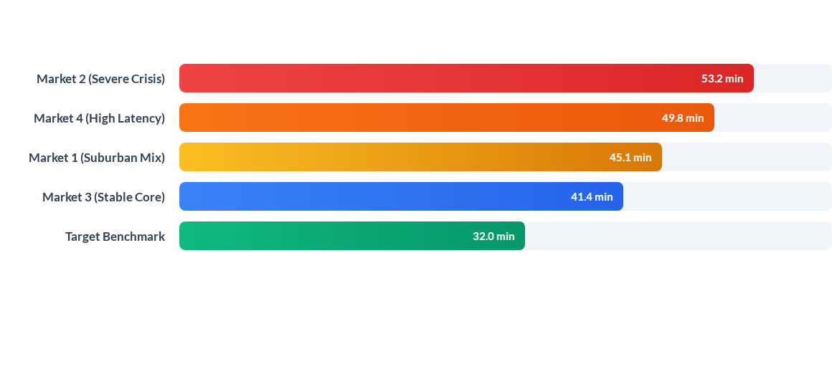
Delivery Duration Across Markets
Markets 2 and 4 represent 47% of total company order volume but suffer the highest latency, accounting for over 72% of all negative customer reviews and cancellation refunds.

Slide 8
Market & Protocol Risk Matrix
Market & Ordering Channel | Order Share | Avg Delivery Time | Dasher Deficit Ratio | SLA Risk
Market 2 – Fast Food & Pizza | 28.4% | 53.2 mins | 1.84 (Severe Backlog) | Critical
Market 4 – Casual Dine-in | 18.6% | 49.8 mins | 1.62 (High Load) | Critical
Protocol 3 – Call-in Dispatch | 12.2% | 51.6 mins | 1.45 (Manual Queue) | High
Market 1 – Mixed Retail | 24.1% | 45.1 mins | 1.18 (Moderate) | High
Protocol 1 – Direct POS Integration | 36.7% | 38.2 mins | 0.92 (Balanced) | Moderate

Slide 9

Fleet Utilization Under Pressure
Dasher Burnout Dynamics
Couriers face compounding idle delays at restaurant counters without compensation, eroding their hourly earnings by 28% during peak hours.
This triggers driver log-offs during dinner rushes, worsening fulfillment backlogs and customer wait times.

Slide 10




Strategic Turnaround Roadmap
Q2 - Merchant SLAs
Q4 - Staged Dispatch
Enforce tablet prep confirmations and penalize merchant wait times over 12 mins.
Sync driver dispatch to actual kitchen completion rather than order receipt.
Q1 - Machine Learning ETA
Q3 - Dynamic Fleets
Institute geofenced surge pay in Market 2 & 4 to boost peak dasher availability.
Deploy multi-feature neural regression models predicting realistic dynamic ETAs.

Slide 11

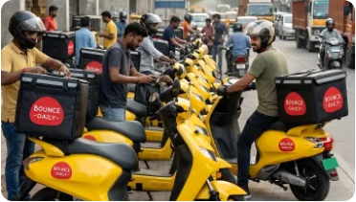
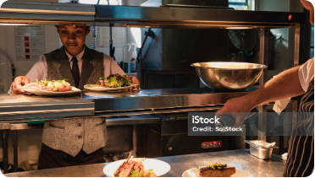
Core Operational Interventions
Dynamic ETA Engine
Supply Re-Balancing
Just-In-Time Dispatch
Replace static rule-based ETAs with neural models accounting for live kitchen queues and traffic.
Proactive fleet relocation to high-order clusters 30 minutes ahead of anticipated demand surges.
Dispatch delivery partners to arrive exactly when food packaging is complete, eliminating idle wait time.

